Slide 1
Estimation of Human Center of Mass and Inertial Parameters via Approximate Bayesian Inference
Robert C Grande and Dr. Doik Kim

Slide 2
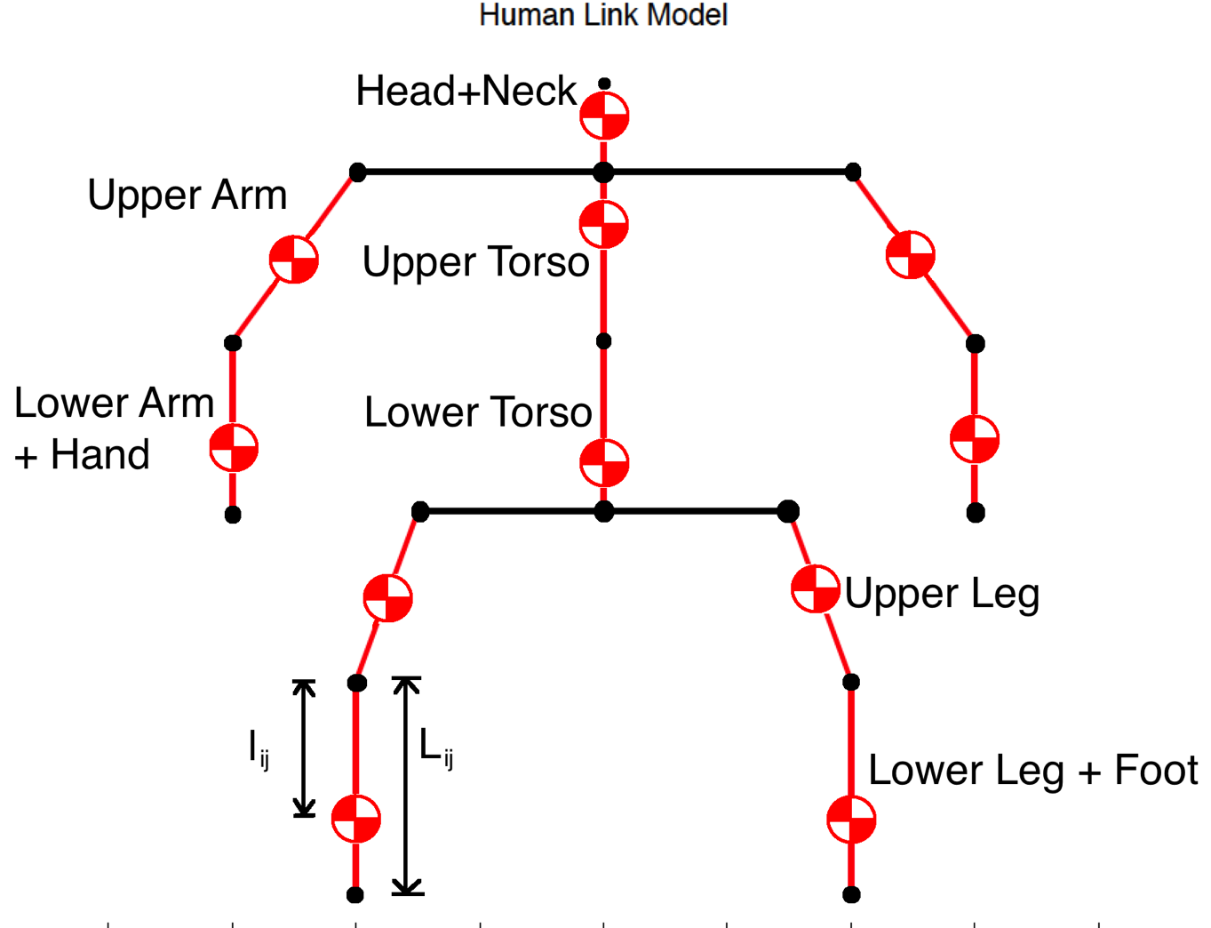
Problem Statement
Estimate Center of Mass (CoM) of human given joint angles from Kinect or Vicon camera
Estimate limb inertial parameters
Limb mass
Limb CoM location
Use low cost sensors and techniques available to general researchers

Slide 3
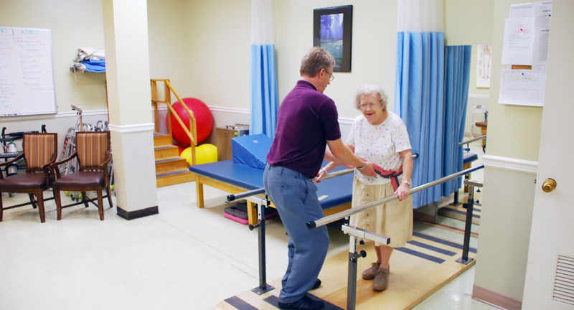
Motivation
Rehabilitation
Fall Prediction

Slide 4
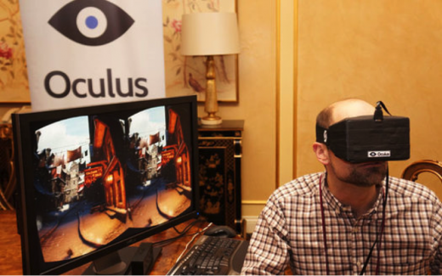
Motivation
Realistic Simulation
Virtual Reality

Slide 5
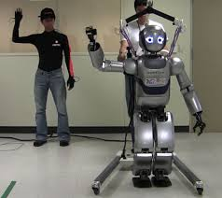
Motivation
Analysis of Human Dynamics
Humanoid Robot Teleoperation

Slide 6
Limitations of Past Approaches
Direct measurement of inertial properties
Using expensive equipment, specialized procedures
Magnetic Resonance Imagery (MRI) [CK Cheng 2000]
Stereoprogrammatic [McConville 1980]
Motion Capture and Force plates [Venture 2008]
Post mortem measurements
Divides corpse into segments and performs analysis directly
Indirect estimation using inverse kinematics models
Limited prediction capabilities
Returns CoM prediction, not limb properties [González 2012]
Require expensive setup: Motion Capture and Force plates
Not guaranteed to return feasible parameters, i.e. negative mass
Our Approach

Slide 7
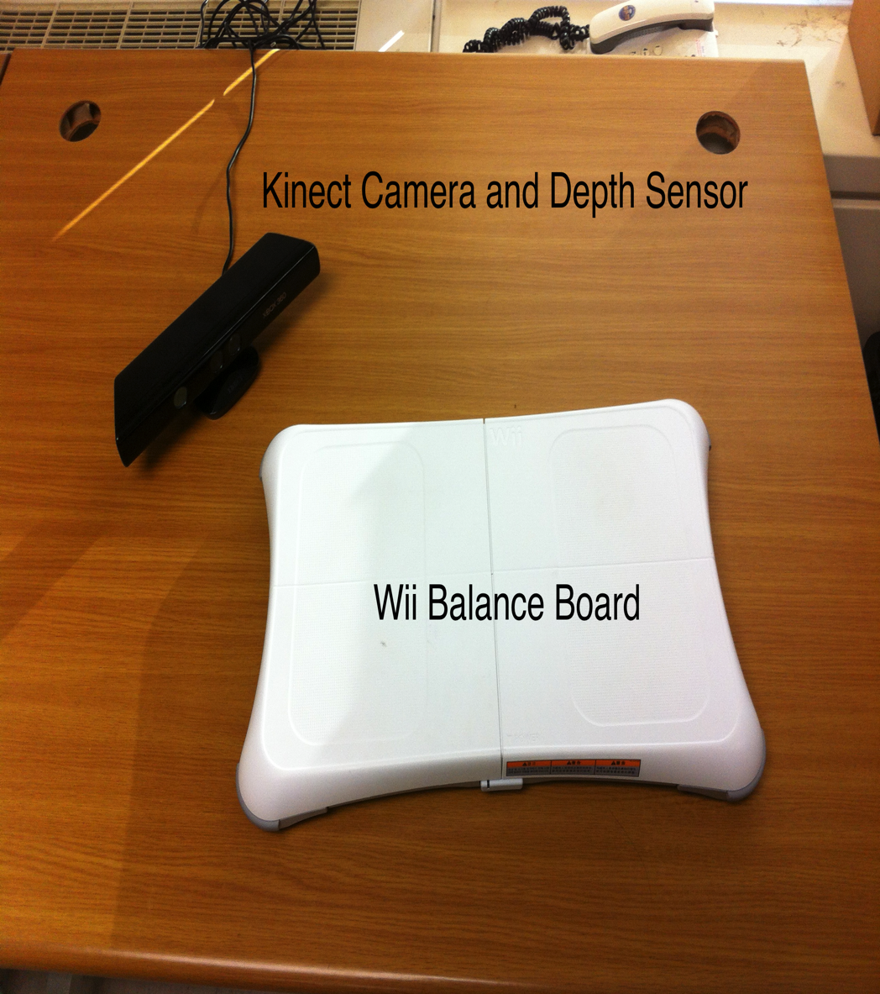
Approach Overview
Collect joint and CoM measurements using Kinect and Wii Balance Board
Use inverse kinematics equations to determine limb properties

Slide 8
Approach Overview
Problem:
Wii and Kinect cannot collect dynamic data
Impossible to estimate intertial parameters from static data alone
Solution:
Formulate problem in probabilistic manner
Use mass distribution data from medical literature as prior distribution
Solve for Maximum A Posteriori (MAP) solution using approximate Bayesian inference

Slide 9
Contributions
Introduce novel method for estimating the CoM and inertial parameters of a human operator
Uses inexpensive and readily available equipment
Wii Balance Board
Kinect Camera
Returns inertial parameter estimates as well as CoM predictions
Returns feasible assignments for inertial parameters
Utilizes wealth of past knowledge from the medical literature.
Outperforms state of the art algorithms in CoM prediction

Slide 10
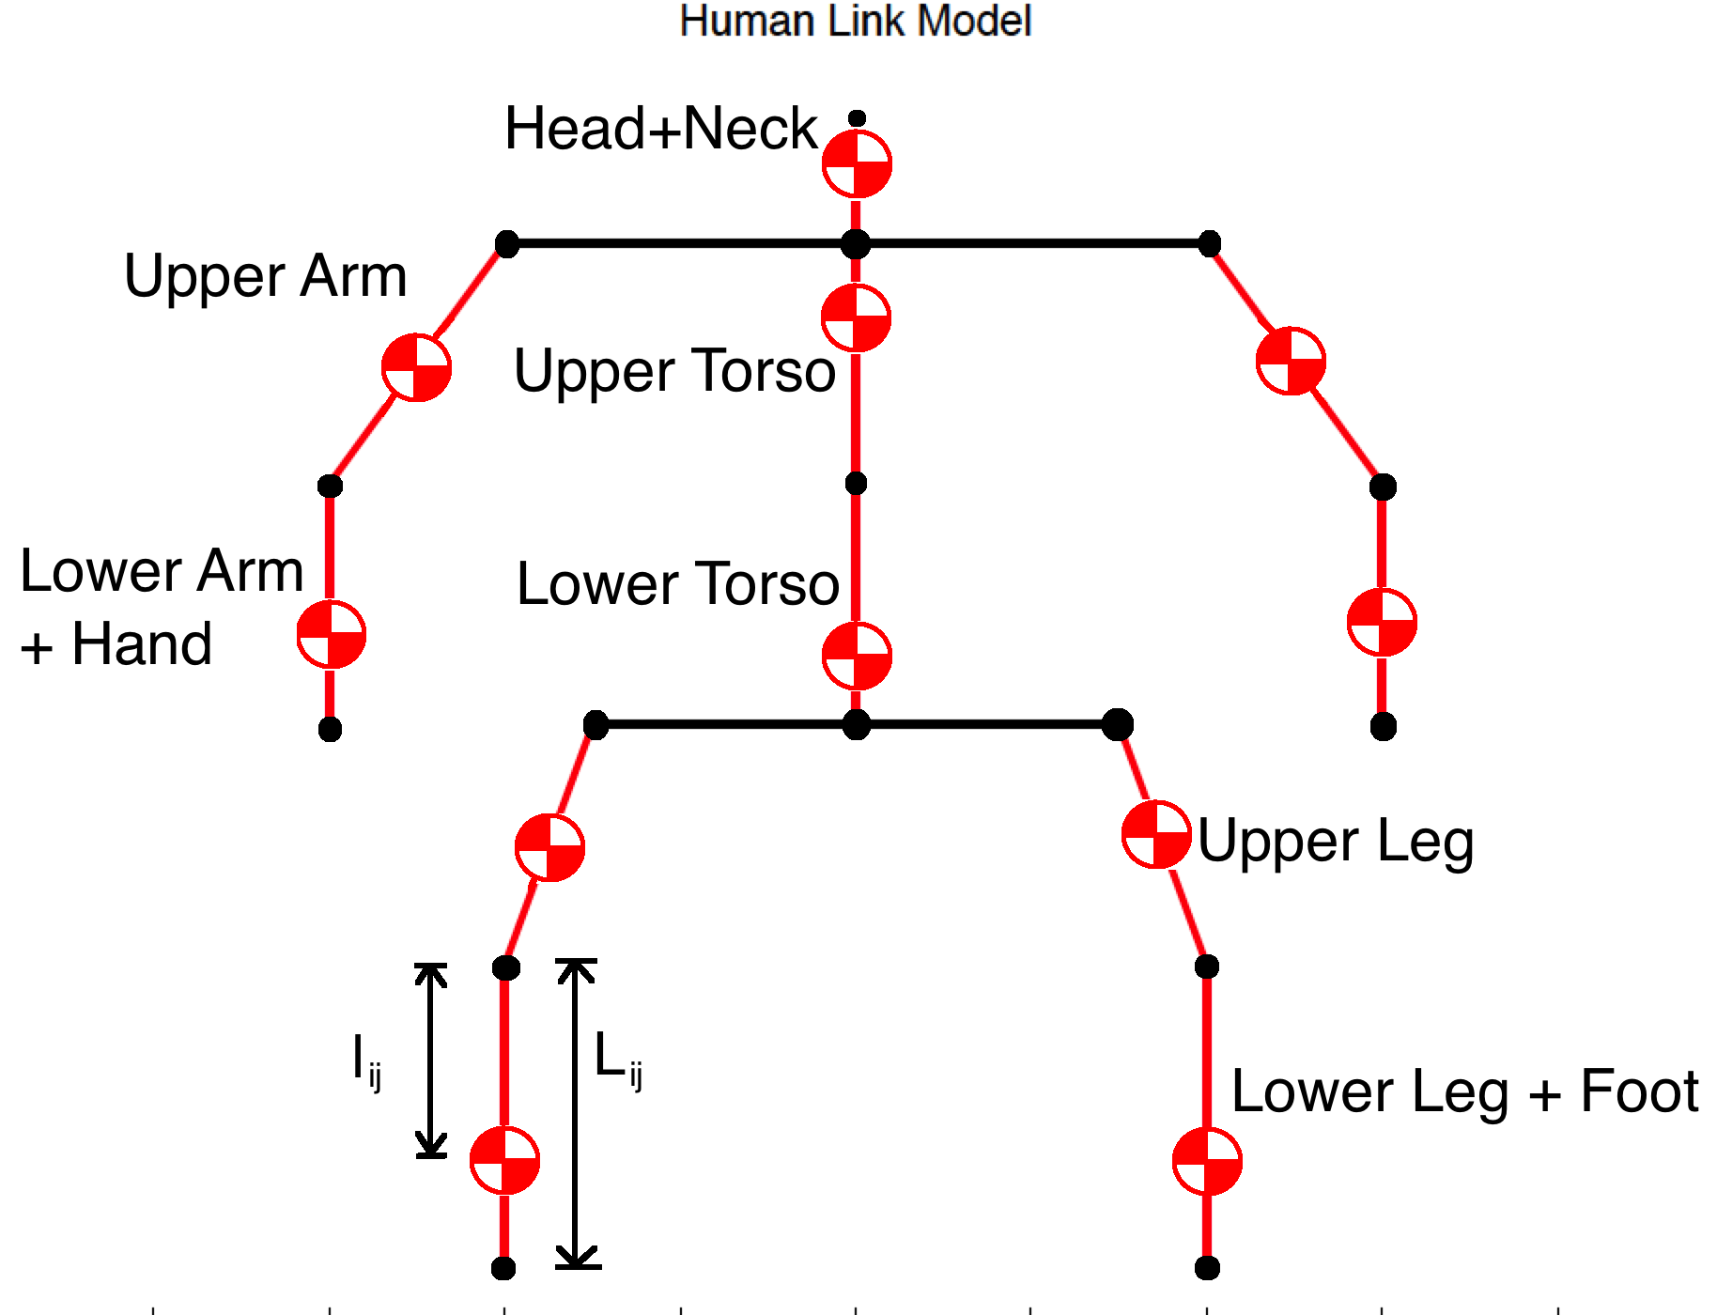
Model

Slide 11
Idea: Least Squares

Slide 12
Problem: Unobservability
Redundant Columns: Observability Problem

Slide 13
Idea: Bayesian Inference
Formulate in probabilistic framework: Bayesian Inference
Given prior probability density function (pdf) p(theta)
Designed by experimenter using medical literature
Observation likelihood pdf p(y|theta): measurement model
Desired: posterior pdf
Z is normalization factor so p(theta|y) integrates to 1
Intractable to compute in practice

Slide 14
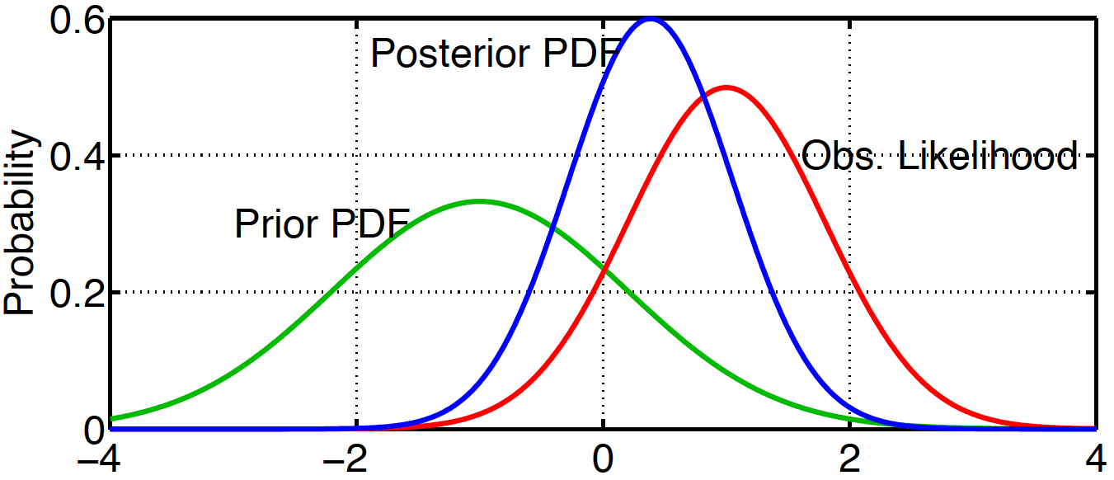
Idea: Bayesian Inference

Slide 15
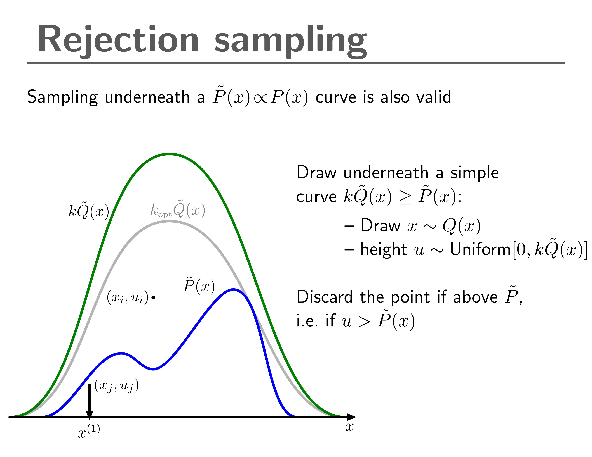
Method 1: Markov Chain Monte Carlo (MCMC)
Idea: Can’t evaluate p(theta|y) directly, but can we draw samples from p(theta|y)? Can then evaluate function proportional to p(theta|y)
Can’t draw samples from p(theta|y), but can we sample from another distribution and alter the result to look like p(theta|y)?
Rejection Sampling

Slide 16
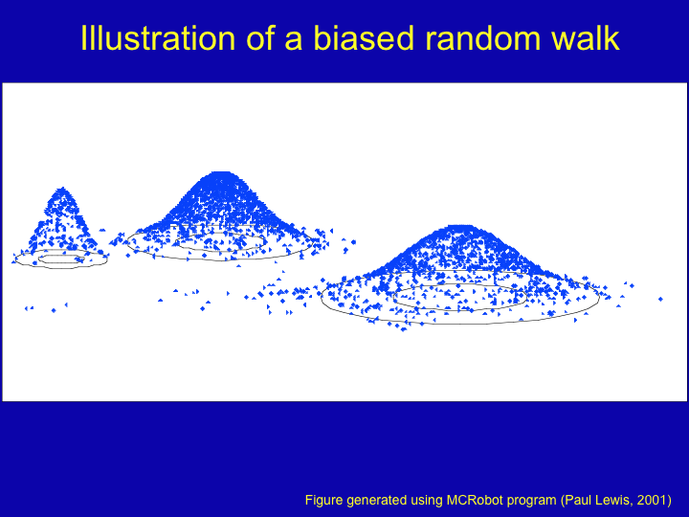
Method 1: Markov Chain Monte Carlo (MCMC)
MCMC: Adaptive Rejection sampling
Create a random walk: Accept new samples proportional to prob of new sample divided by prob of old sample

Slide 17
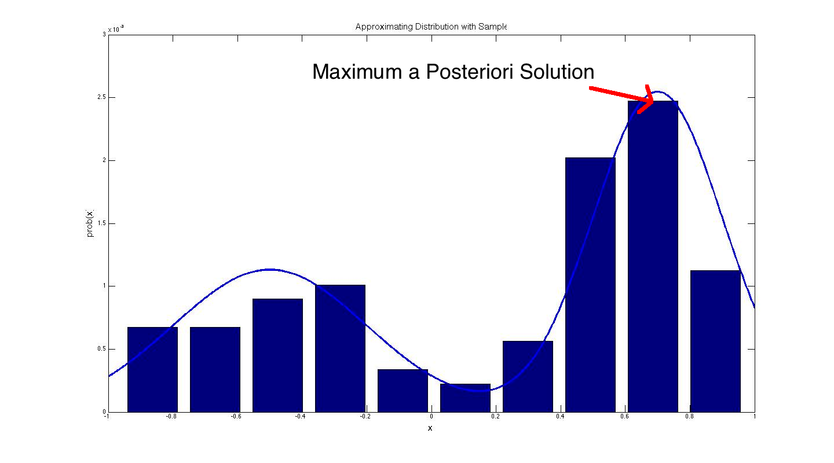
Markov Chain Monte Carlo (MCMC)

Slide 18
Method 2: Particle Filter
MCMC works well for batch data, but how about online methods?
Can offer user feedback to encourage exploration [González 2013]
Idea: approximate continuous function using discrete set of basis functions
Normalization becomes trivial sum
Updates reduce to simple multiplicative updates of weights
MAP calculation becomes search over discrete objects

Slide 19
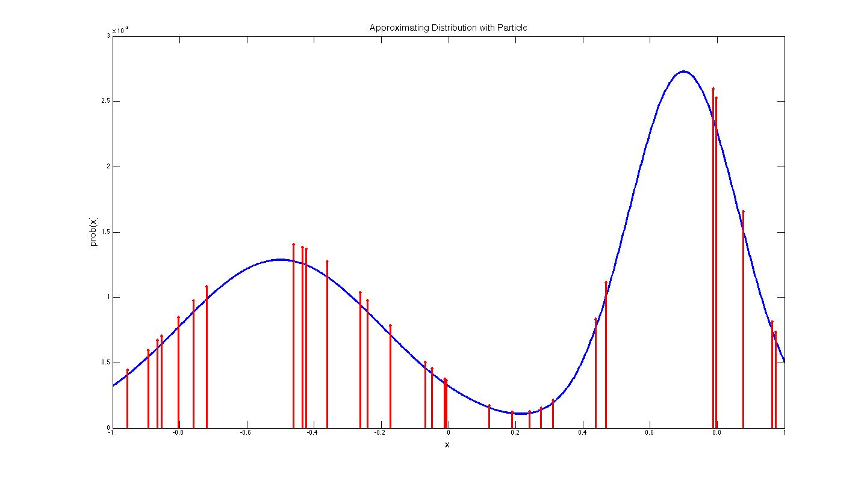
Particle Filter

Slide 20
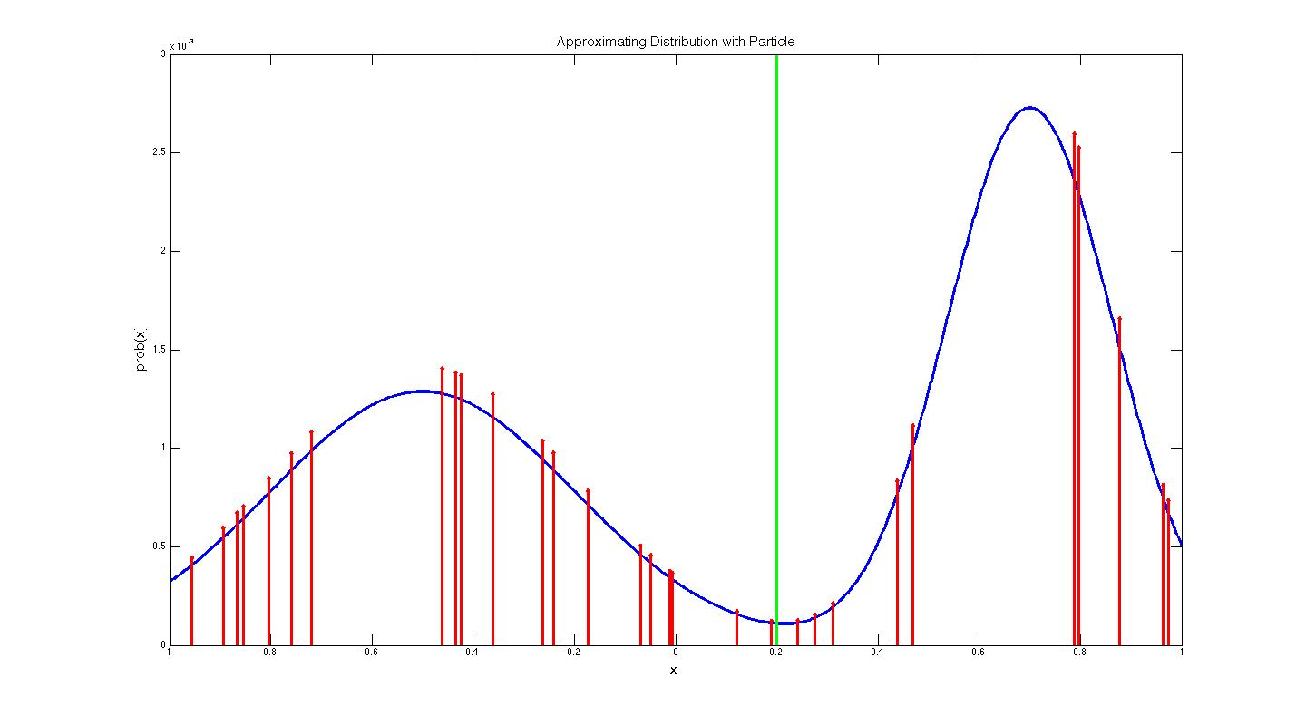
Particle Filter

Slide 21
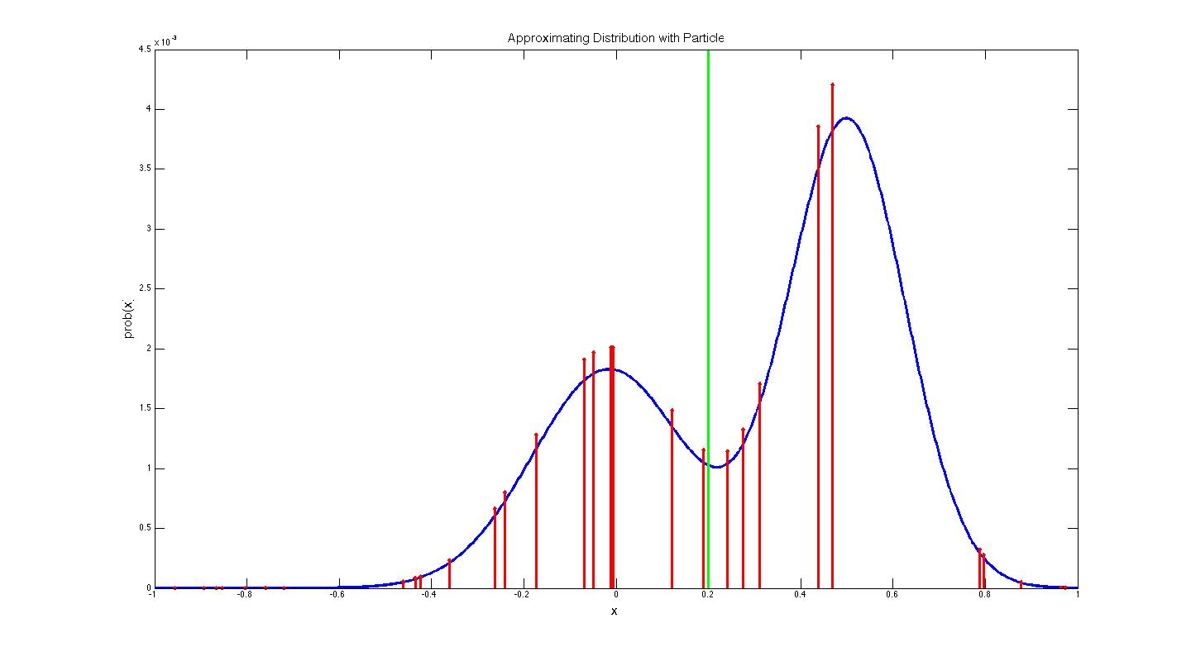
Particle Filter

Slide 22
Prior Formulation

Slide 23
Results: CoM Prediction: MCMC

Slide 24
Results: CoM Prediction: Particle Filter

Slide 25
Results: CoM Prediction: Gonzalez et. al

Slide 26
Results: Inertial Properties

Slide 27
Conclusions
Introduced novel method for determining inertial parameters of human
Used low cost Wii Balance Board and Kinect Camera
Used Bayesian inference and distributional data from the medical literature
Solves problem of observability
Adds regularization to the problem
Better CoM prediction accuracy than state of the art algorithms
Realistic estimates of inertial parameters

